Slide 1
ENSF 592 Final Project
Authors: Patrick Pickard, Joshua Posyluzny
Presentation Date: August 13, 2020

Slide 2
Project Topics
Area of Interest
Grid The City
Master DataFrame
Data Visualization
Conclusion

Slide 3
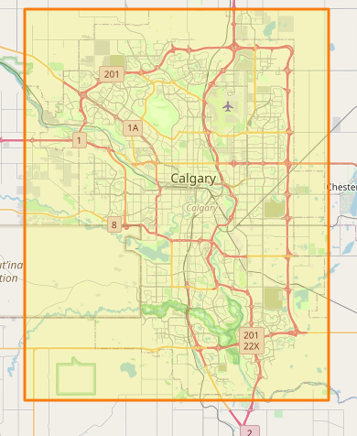
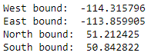
Area of Interest
The goal of this project is to analyze various traffic data inside the following orange square section, which defines the maximum boundaries of the city of Calgary, and attempt to draw correlations between the data and the number of incidents that occurred inside this area in 2018.

Slide 4
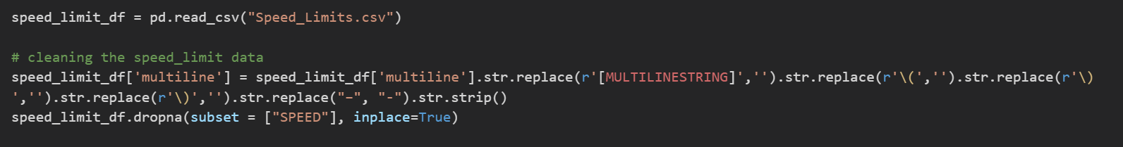
Cleaning the Datasets
All csv files were read into panda dataFrames. Any character encoding errors were stripped out and replaced. Columns that were not pertinent or useful to our analysis were dropped and the remaining columns were ordered . Date and time data were formatted to correctly. The columns containing the data we planned to use were sorted.
Any hourly datasets (weather visibility data), were resampled for daily averages and appended to existing weather dataFrame.
The multilinestring coordinates for locations were formatted from lon, lat to lat, lon.

Slide 5
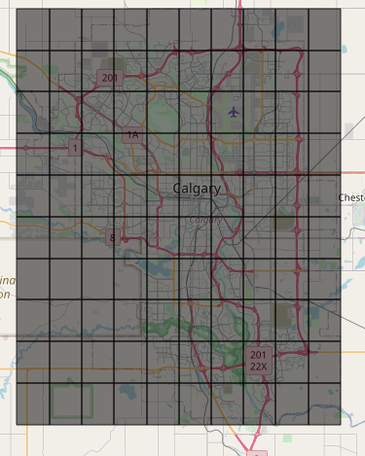
Grid The City
The city grid was built using the pd.cut function from Pandas to build 10 equal size bins for both latitude and longitude using the max and min of each. The bins were then used to create the grid breakdown inside the DataFrame and the GeoJson file that was used to generate the Choropleth maps.

Slide 6
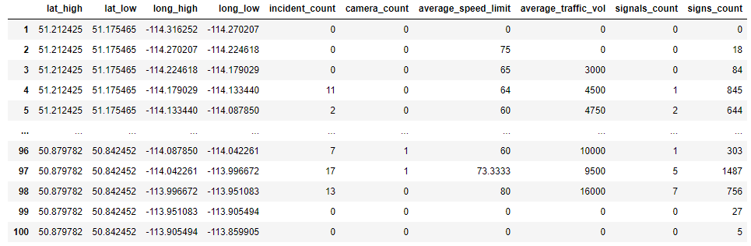
Master DataFrame
Our Master DataFrame is organized as follows:
Index refers to the grid number. Grids start at the top left of the map, and go left to right, up to down
lat_high, lat_low, long_high, and long_low define the boundaries of each grid
Data for the remaining columns/features are found using loops to traverse the cleaned data to find how many of each feature occur in each grid, and the counts/averages for each feature are displayed for the grid

Slide 7
Data Visualization
The following slides will show visualization for the analyzed data in the forms of maps and plots

Slide 8
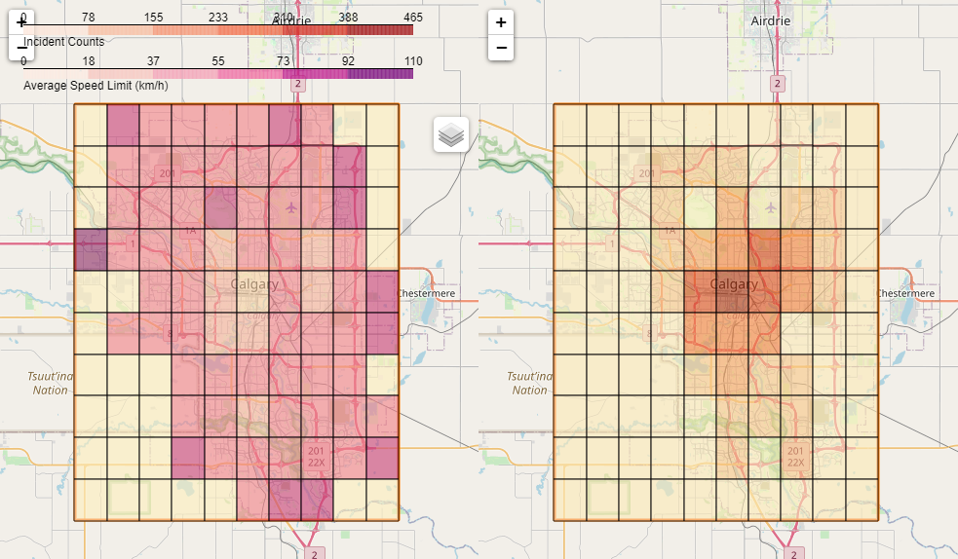

Traffic Incidents vs Average Speed Limits
These data show the lowest correlation.

Slide 9
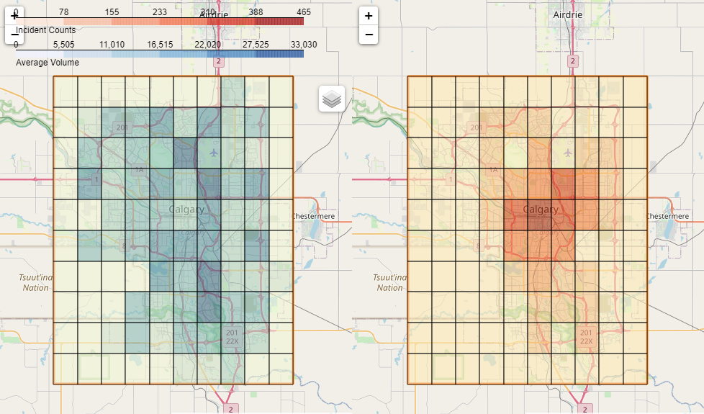

Traffic Incidents vs Average Traffic Volume
These data show very strong correlation.

Slide 10
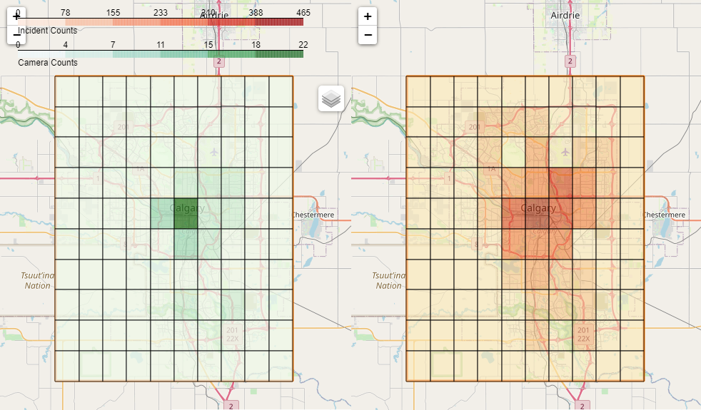

Traffic Incidents vs Traffic Cameras
These data show very strong correlation.

Slide 11
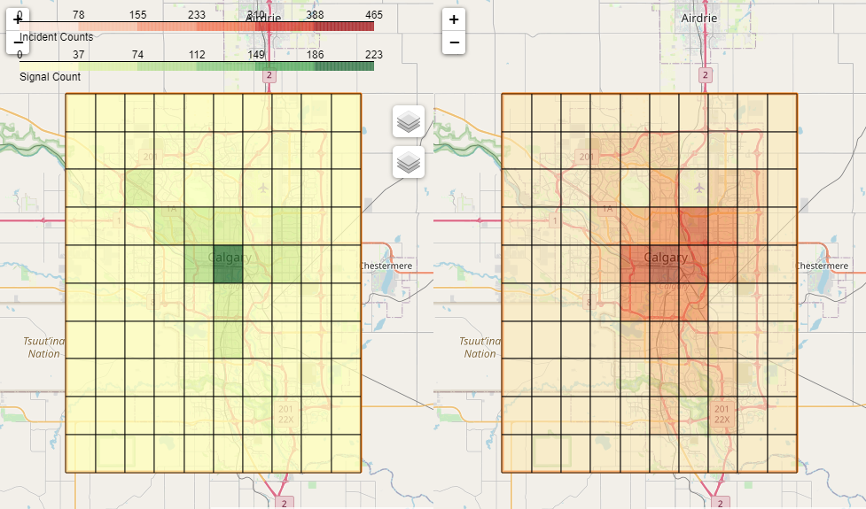

Traffic Incidents vs Traffic Signals
These data show the strongest correlation.

Slide 12
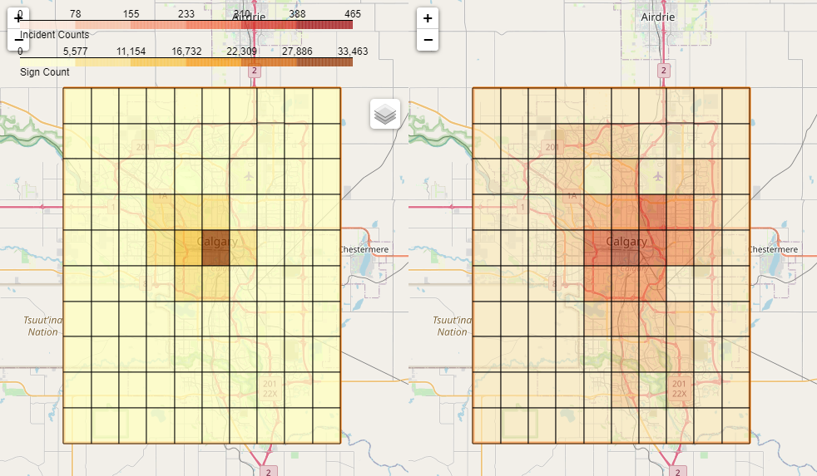

Traffic Incidents vs Traffic Signs
These data show very strong correlation.

Slide 13
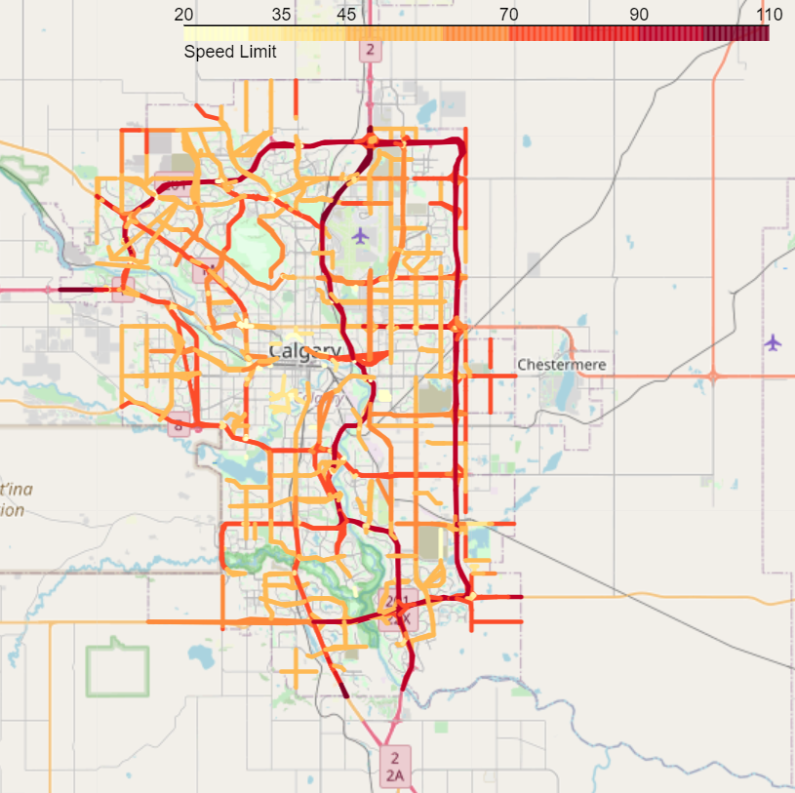
Road Speed Limits

Slide 14
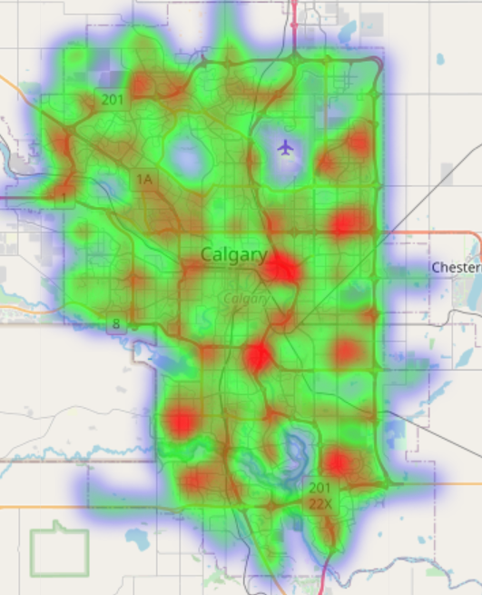
Heatmap by Traffic Volumes

Slide 15
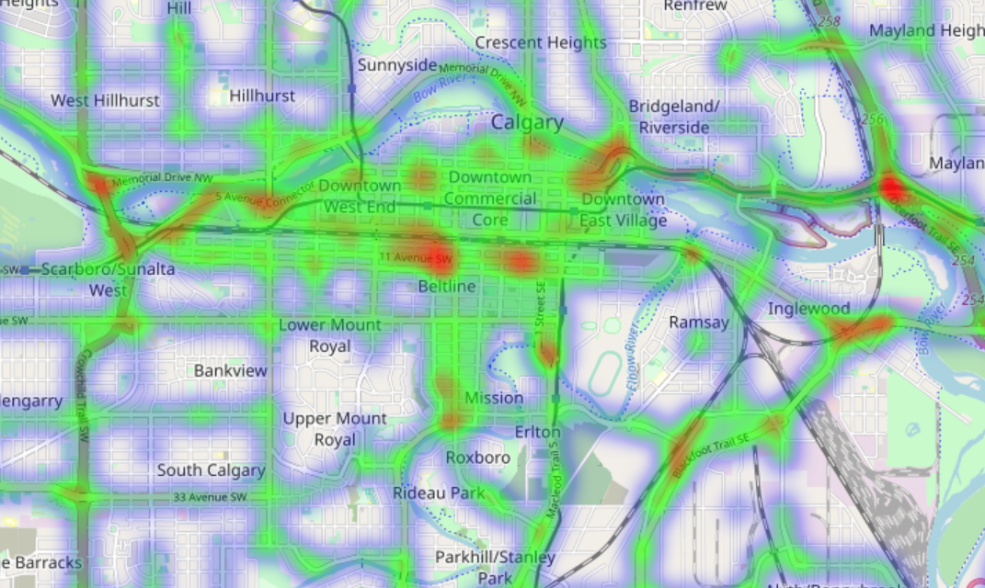

Slide 16
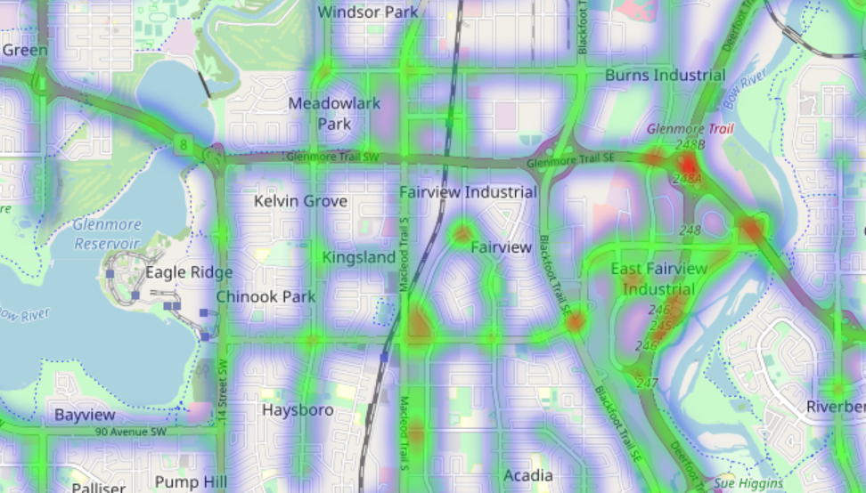

Slide 17
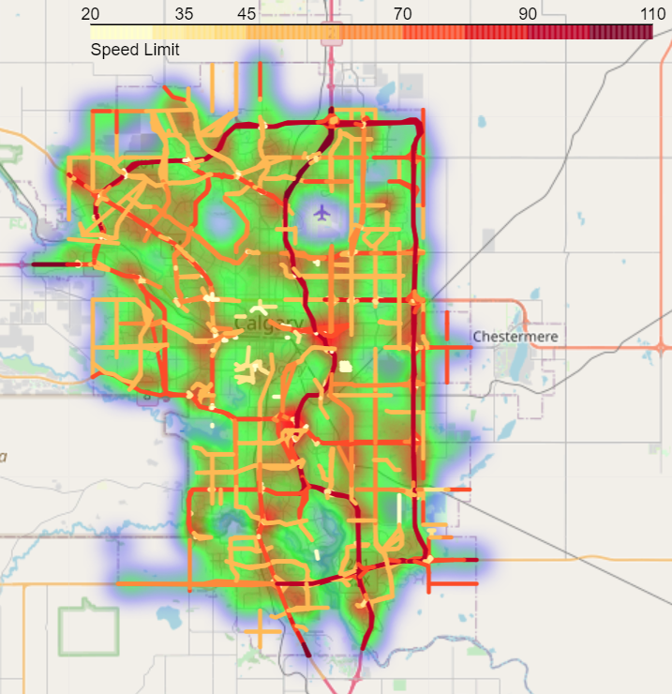
Traffic Volume Heatmap & Road Speed Limits

Slide 18
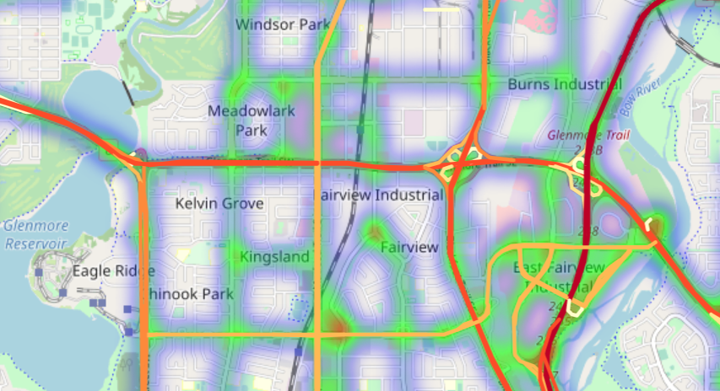

Slide 19
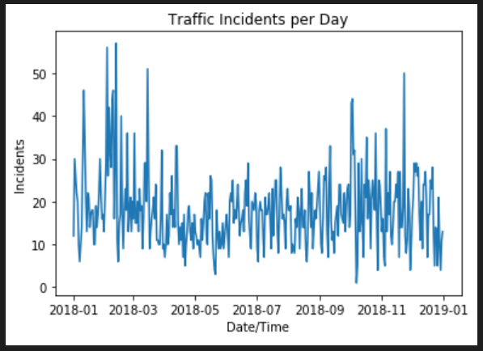
Hard Data Visualization – Plots
There is very weak correlation between seasons and incident volumes (see next slide).
The spearman coefficient of correlation for each of these graphs can be seen below each plot.

Slide 20
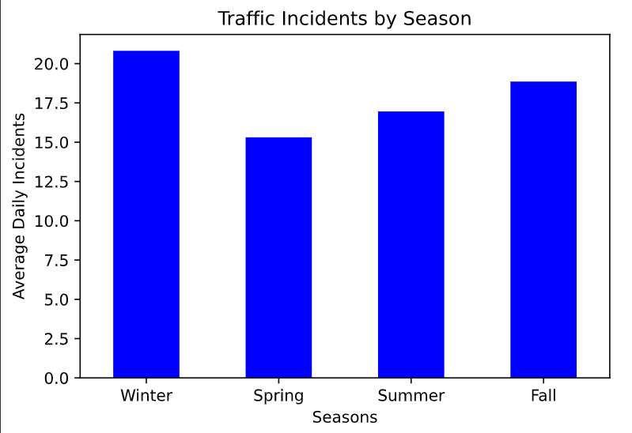

The only moderate conclusion that can be drawn from this graph is that there are, on average, more incidents in the fall and winter months, October – March, compared to the spring and summer months, April – September.

Slide 21
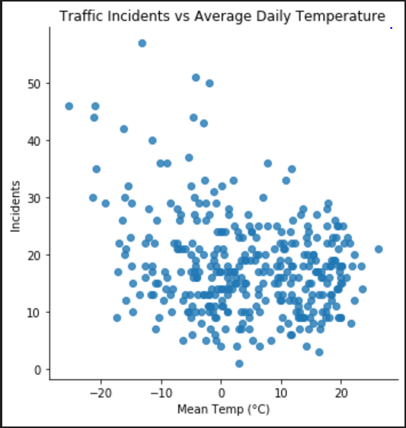

Hard Data Visualization – Plots
There is no significant correlation between the average daily temperature and the number of traffic incidents. (Very slightly more at lower mean temperatures, but not statistically signifcant)

Slide 22
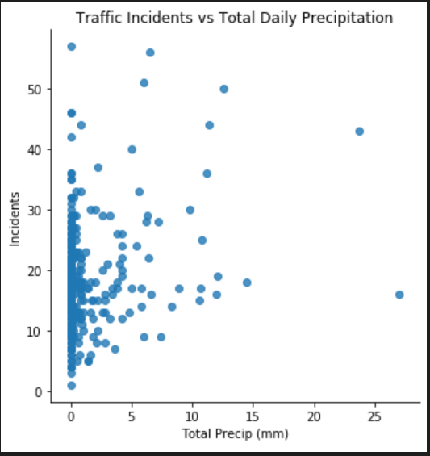

Hard Data Visualization – Plots
There is weak correlation between the total daily precipitation and the number of traffic incidents.

Slide 23
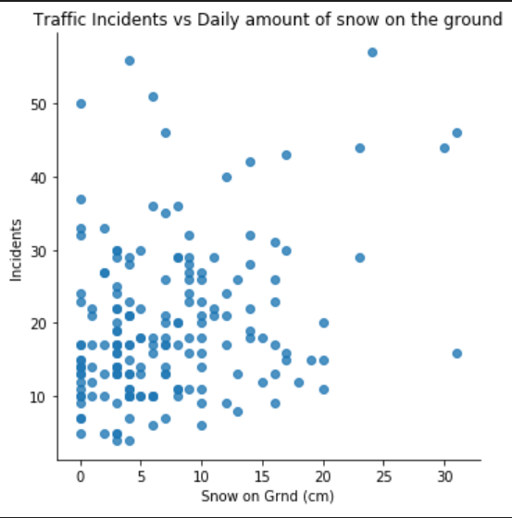

Hard Data Visualization – Plots
There is no significant correlation between the daily amount of snow on ground and the number of traffic incidents.

Slide 24
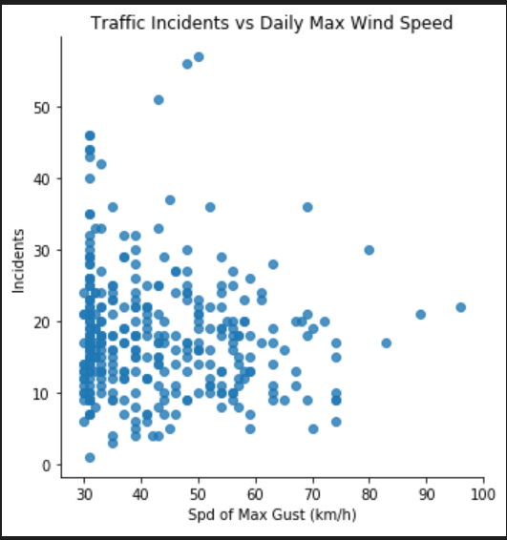

Hard Data Visualization – Plots
There is weak correlation between the daily max wind gust speed and the number of traffic incidents.

Slide 25
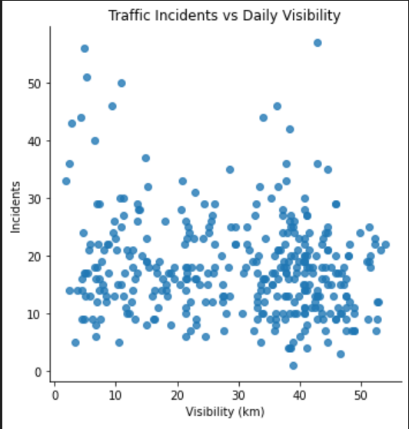

Hard Data Visualization – Plots
There is no significant correlation between the daily visibility and the number of traffic incidents.

Slide 26
Conclusion

